Slide 1

Faculty appraisal system
by
S.M Sakiya Rabbani
Roll No. 204G1A0591
P. Gana Sree Akshaya
Roll No. 204G1A05C7
M. Saranya
Roll No. 204G1A0593
P. Mehaboob Arab Khan
Roll No. 214G5A0508
Under the guidance of
Dr.M.Ranjit Reddy M.Tech.Ph.D
Professor
Department of Computer Science and Engineering
Srinivasa Ramanujan Institute of Technology
(Autonomus)
2023 - 2024

Slide 2

Contents
Abstract
Introduction
Literature Survey
Existing System
Proposed System
Planning and Design
Implementation
Research Paper
Conclusion
References

Slide 3
Comments
User interface is less attractive
Can multiple years of faculty data can be stored ?
Is there any Assessment method to check performance of the faculty ?
Which data analytic methods is used ?

Slide 4
Abstract
Faculty performance appraisal predominantly relies on paper-based assessments and the manual calculation of points based on a range of factors. These factors encompass cognitive abilities, educational achievements, professional accomplishments, and other relevant attributes that contribute to an individual's intellectual prowess. This traditional approach is undergoing a transformation through the integration of technology, specifically utilizing data analytics techniques.
Faculty appraisal system revolutionizes the assessment of faculty by using data visualization and a dynamic web page. Faculty members log in to provide their achievements through a user-friendly form. The system assigns points to each accomplishment based on predefined weights, offering real-time feedback and visualizations on the final appraisal points.
KEYWORDS: Faculty Performance, Data Visualization, Faculty Appraisal System.

Slide 5
Introduction
The Faculty Appraisal System marks a pivotal shift from traditional paper-based assessments to a technologically advanced and data-driven approach in evaluating the performance of academic professionals. In the contemporary landscape of higher education, assessing faculty members' contributions requires a comprehensive and dynamic system. This project introduces an innovative solution that leverages data analytics techniques and a user-friendly web interface to streamline the appraisal process.
The system invites faculty members to log in and document their cognitive abilities, educational achievements, professional accomplishments, and other relevant attributes via an intuitive form. Points are automatically assigned to each accomplishment based on predefined weights, facilitating a fair and transparent evaluation. Real-time feedback and visualizations are provided, offering both faculty members and administrators valuable insights into the appraisal points. The Faculty Appraisal System not only modernizes the assessment methodology but also enhances efficiency, objectivity, and the overall quality of faculty performance evaluations in the academic realm.

Slide 6
Problem Statement
Faculty performance appraisal predominantly relies on paper-based assessments and manual calculation of points based on a range of factors. Creating an intelligence appraisal system that assists academic institutions in making informed decisions about promotions, salary adjustments, and recognition necessitates aligning the outcomes with institutional goals and policies.
Developing a report generation mechanism that translates accumulated points into clear appraisal insights and potential increments, promoting transparency and trust among faculty and stakeholders

Slide 7
Literature Survey
[1]. Haidi Bozikovic, Maja Stula has proposed the The use of PHP, JavaScript, CSS, and the XAMPP server highlights the efficient development process and modern tech choices. The benefits of implementing Single Sign-On solutions, which allow faculty members to access multiple systems with a single set of credentials, enhancing convenience and security.
[2]. Aisha Khanam, Dr. Shabana Mazhar has proposed a well-designed and properly implemented faculty performance appraisal systems have the potential to enhance accountability, quality assurance, decision-making, professional development, and motivation within higher educational organizations. Online systems reduce the risk of errors often associated with manual data entry. Automated calculations and standardized evaluation criteria contribute to higher data accuracy and integrity, leading to fair and reliable assessment outcomes.

Slide 8
Literature Survey
[3]. Patrik Bores, Aishwarya Chinch pure, Rajat Singh Deepak , Dr. Swati Shinde has proposed exploratory data analysis methods to understand trends and patterns descriptive analytics for summarizing faculty performances metrics predictive modeling techniques to forecast faculty performances. Ethical implications of using data science in faculty appraisal ensuring fairness and transparency in the appraisal process. The methods of collecting relevant data for faculty appraisal techniques for cleaning and preprocessing the collected data, data privacy and ethical consideration in handling faculty-related data. Identification of key features that impact performances for creating new features to enhance predictive model and feature selection and engineering.

Slide 9
Existing System
The existing Faculty Appraisal System relies on paper-based assessments and manual point calculations. It evaluates faculty members based on cognitive abilities, educational achievements, professional accomplishments, and other relevant attributes. However, this traditional approach lacks efficiency and real-time feedback. The system is undergoing a transformation with the integration of technology, incorporating data analytics and a dynamic web page for faculty members to input achievements and receive instant, visually presented appraisal points.
Disadvantages:
Time Consuming Process
Risk Of Errors
Limited Accessibility and Visibility

Slide 10
Proposed System
The proposed Faculty Appraisal System revolutionizes traditional faculty assessments by leveraging data analytics and a dynamic web interface. Faculty members engage with a user-friendly form to input their achievements, while the system assigns points to each accomplishment using predefined weights. This intelligent appraisal system ensures real-time feedback and visualizations, enhancing the efficiency and transparency of the appraisal process for academic institutions.
Advantages:
Efficiency and Timeliness
Transparency and Fairness
Data-Driven Insights

Slide 11
Planning
Requirements
Hardware Requirements
Processor : I3/Intel Processor
Operating System : Windows 7/8/10
RAM : 8 GB
Hard disk : 500 GB
Software Requirements
Database : Mysql
Backend : Express
Run-time environment : Node
Front End : React
IDE : Visual studio Code

Slide 12
Planning
Functional Requirements
The system should have a secure user authentication mechanism to ensure that only authorized faculty members can access and input their appraisal data.
A user-friendly input form should be provided to faculty members for entering their achievements, which should include fields for cognitive abilities, educational achievements, professional accomplishments, and other relevant attributes.
The system should incorporate an algorithm that assigns points to each accomplishment based on predefined weights, reflecting the importance of different factors in the appraisal process.
The system should provide real-time feedback to faculty members, showing the accumulated points as they input their achievements. This feedback can help them understand the impact of their submissions on the overall appraisal.
The system should generate visualizations, such as graphs or charts, to represent the faculty members' appraisal points. This helps in presenting a clear and concise overview of their performance

Slide 13
Planning
Non-Functional Requirements
Security: The system should adhere to robust security measures, including encryption and secure data storage, to protect sensitive faculty information.
Scalability: The system should be scalable to accommodate a growing number of faculty members, ensuring optimal performance as the user base expands.
Reliability: The system should be reliable, with minimal downtime and a backup mechanism to prevent data loss in case of unexpected issues.
Usability: The user interface should be intuitive and user-friendly, requiring minimal training for faculty members to navigate and input their appraisal data.4
Performance: The system should have acceptable response times, even when handling a large volume of concurrent users, to ensure a seamless and efficient appraisal process.

Slide 14
Planning
Objectives
To develop web based faculty performance appraisal system by giving the relevant access to the faculty. To implement data visualization to the data obtained and provide analysis of the appraisal points achieved by faculty.
Scope
The Faculty Appraisal System aims to modernize traditional performance assessments through the integration of data analytics and technology. This system will provide a dynamic web-based platform where faculty members can log in and submit their achievements via a user-friendly form. The system will employ predefined weights to assign points to each accomplishment, offering real-time feedback and visualizations for a comprehensive and efficient appraisal process.

Slide 15
Planning
Time Estimation
SI.No | Activity | Duration
1 | Domain Selection | 1 Week
2 | Literature Survey and problem definition | 2 Week
3 | Planning and Designing | 2 Week
4 | Learnt Mysql, react ,node and Express | 1 Week
5 | Developing the code | 3 Week
6 | Developing the data visualization | 2 Week
7 | Testing the Form | 2 Week

Slide 16
Planning
MODULES
Admin
Login: Admin will login into the application by entering the valid details like (username and password).
View List of Faculty: Admin view the list of faculties.
View Profiles of Faculty: Admin view the profiles of faculties individually.
Add Scores: provide scores for faculty individually for each section.
Logout: Admin must be logout
Faculty
Register: Faculty register with his details
Login: Faculty will login into the application by entering the valid details like (username and password).
Sections: Fill his all sections (section-a, section-b, section-c & section-d)

Slide 17
Planning
Profile: Faculty view his profile.
Scores: Faculty view his score provided by admin based on his profile.
Logout: Faculty must be logout

Slide 18
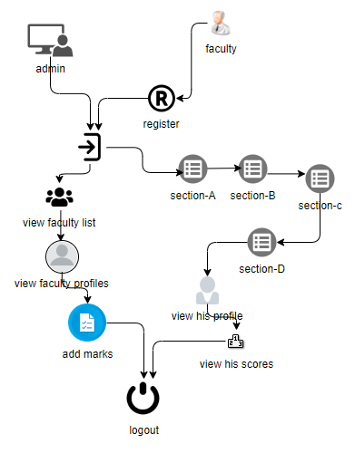
Design
Fig 1. System Architecture

Slide 19
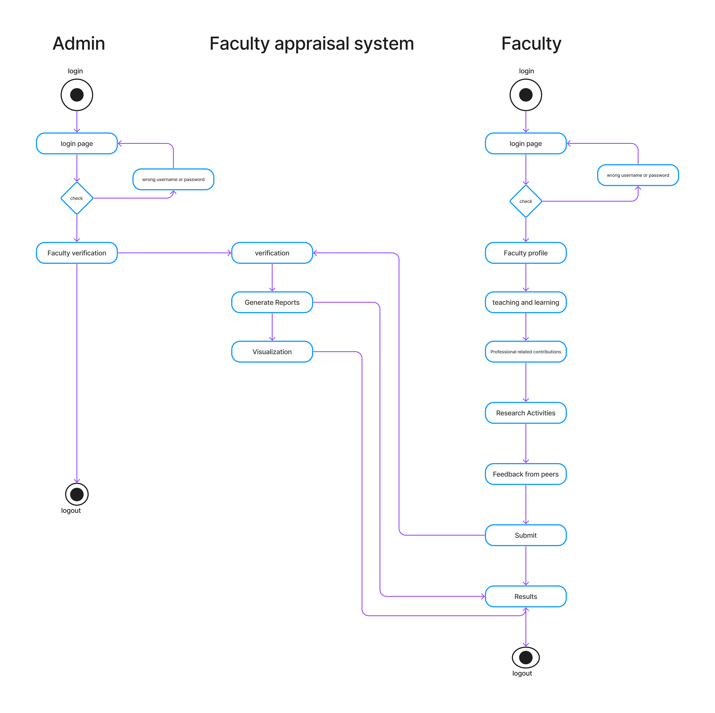
Design
Fig 2. Activity Diagram

Slide 20
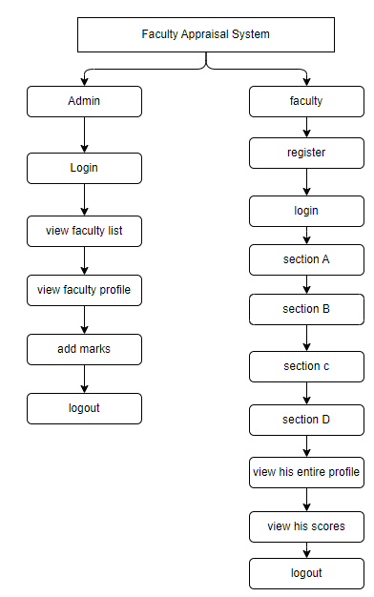
Design
Fig.3 Work flow diagram

Slide 21
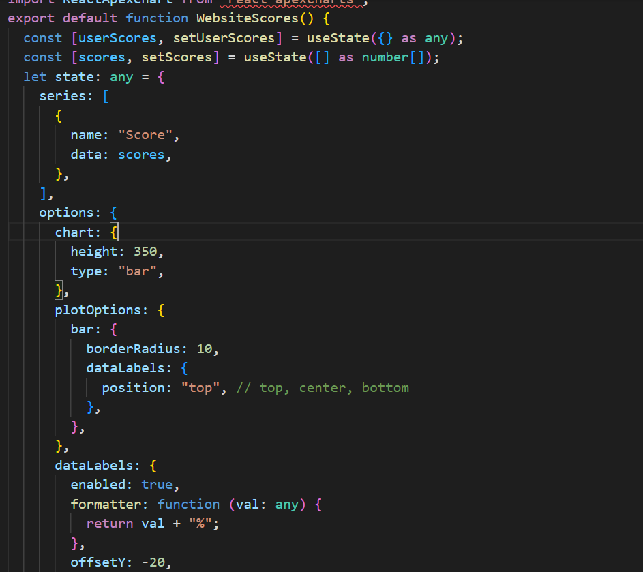
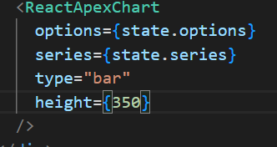
Implementation

Slide 22
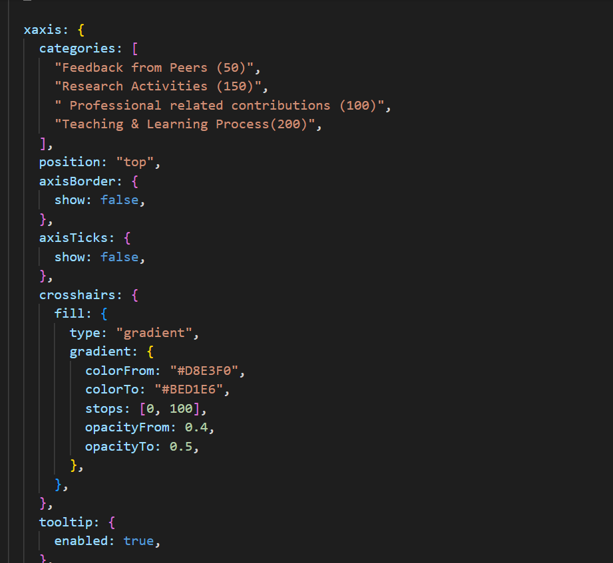
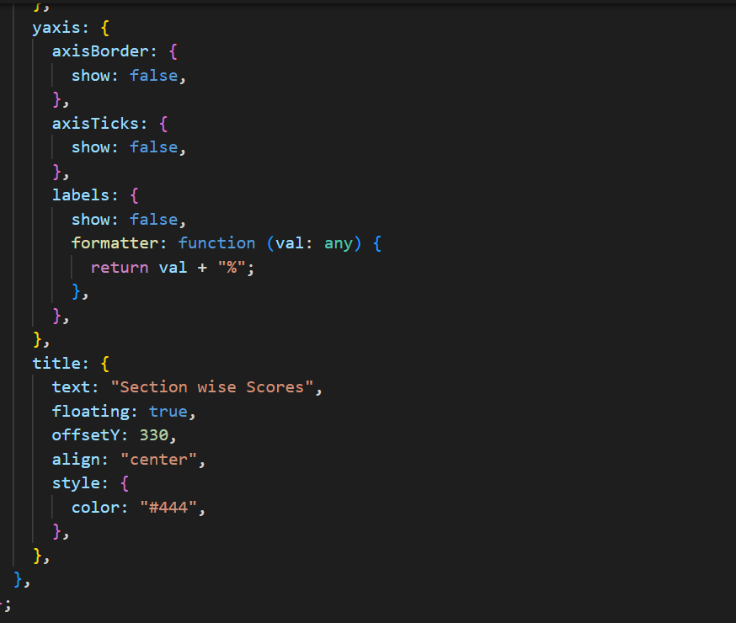
Implementation

Slide 23
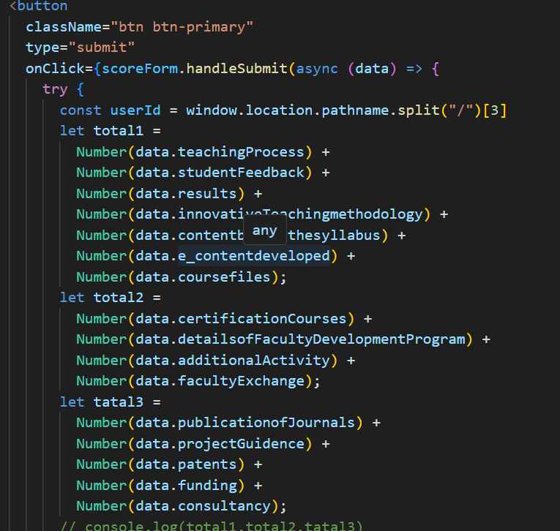
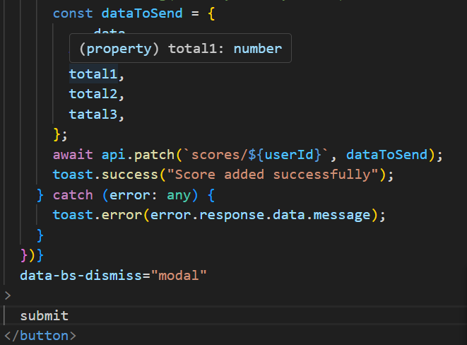
Implementation

Slide 24
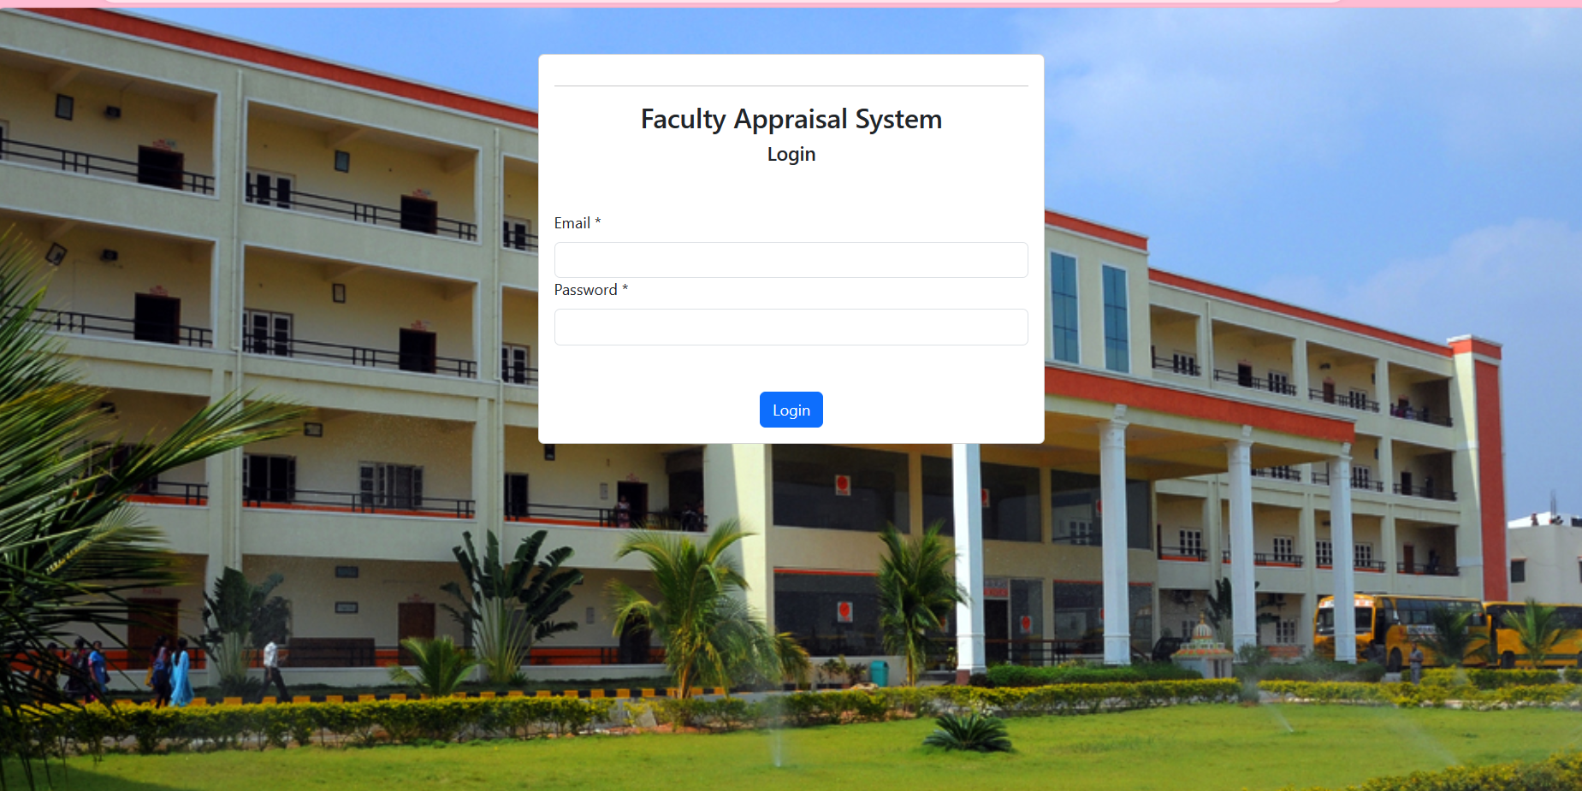
Implementation
Faculty login

Slide 25
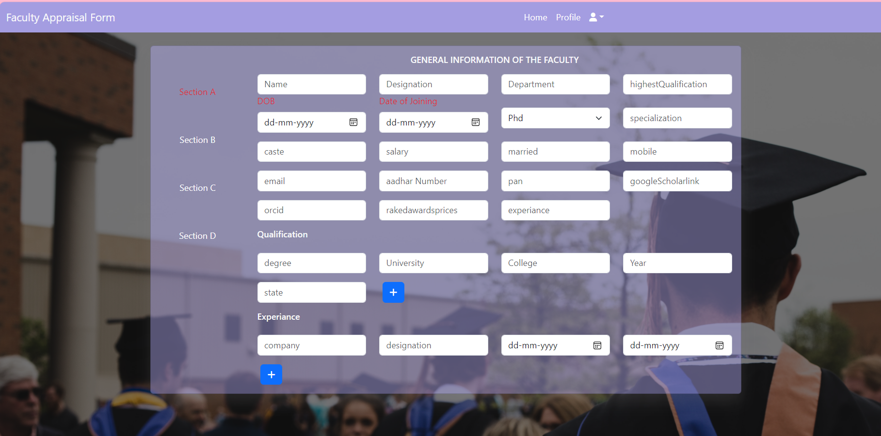
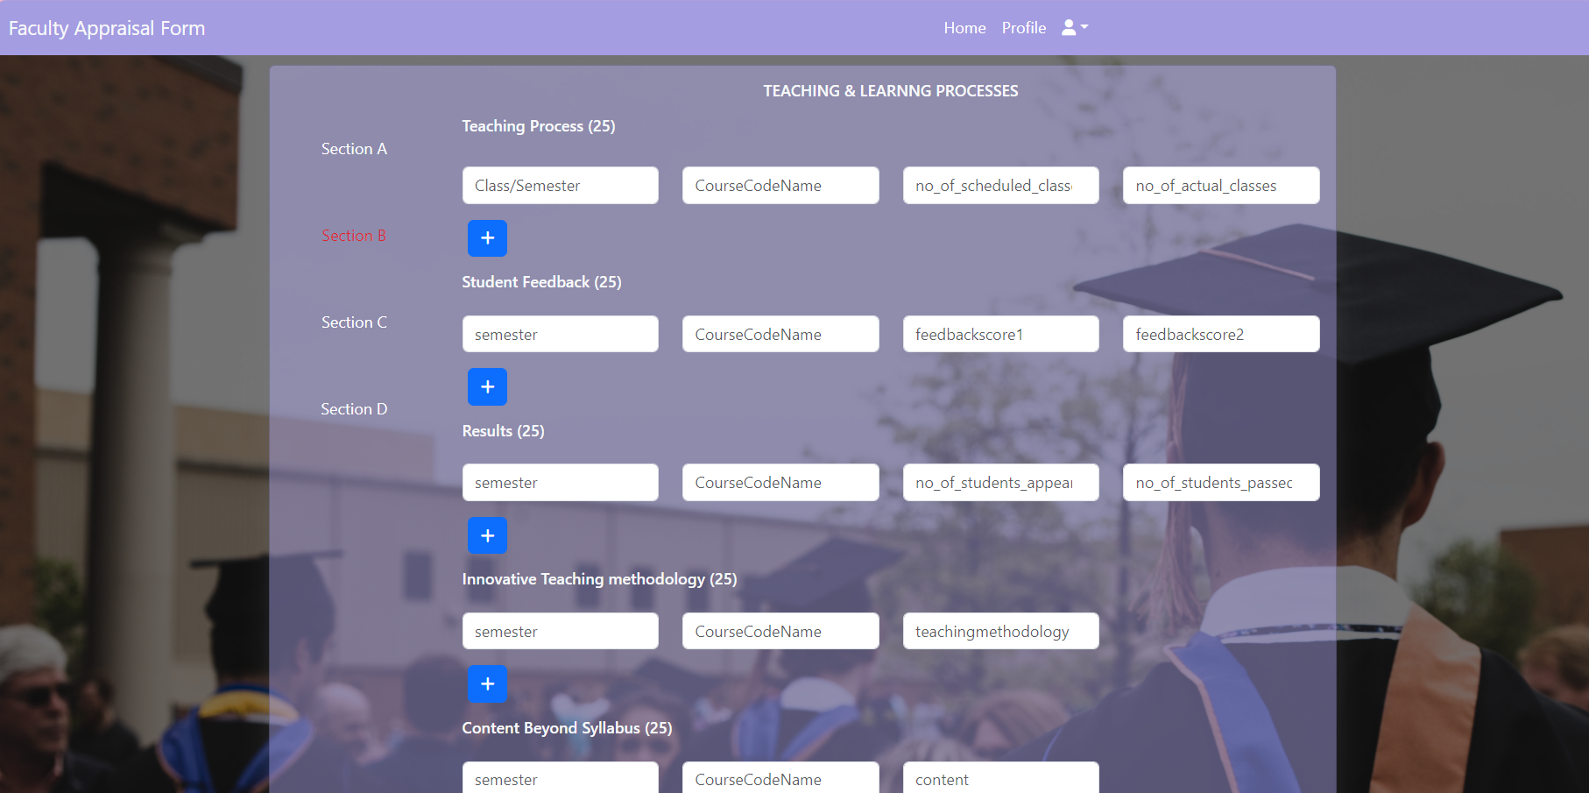
Implementation
Faculty Appraisal Form (Section A & Section B)

Slide 26
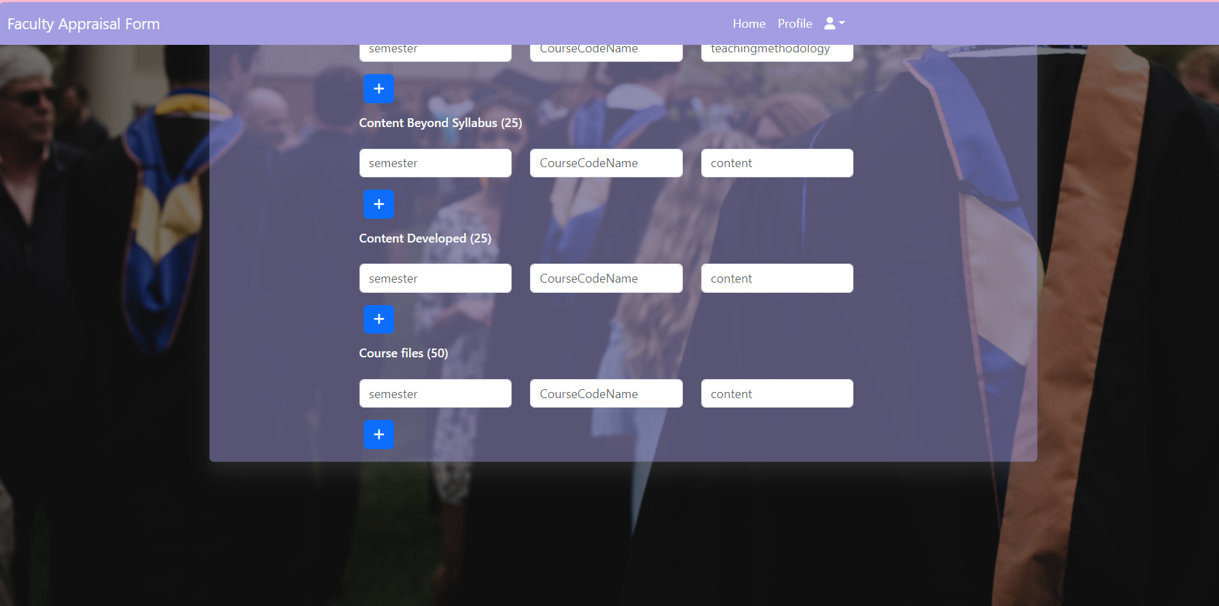
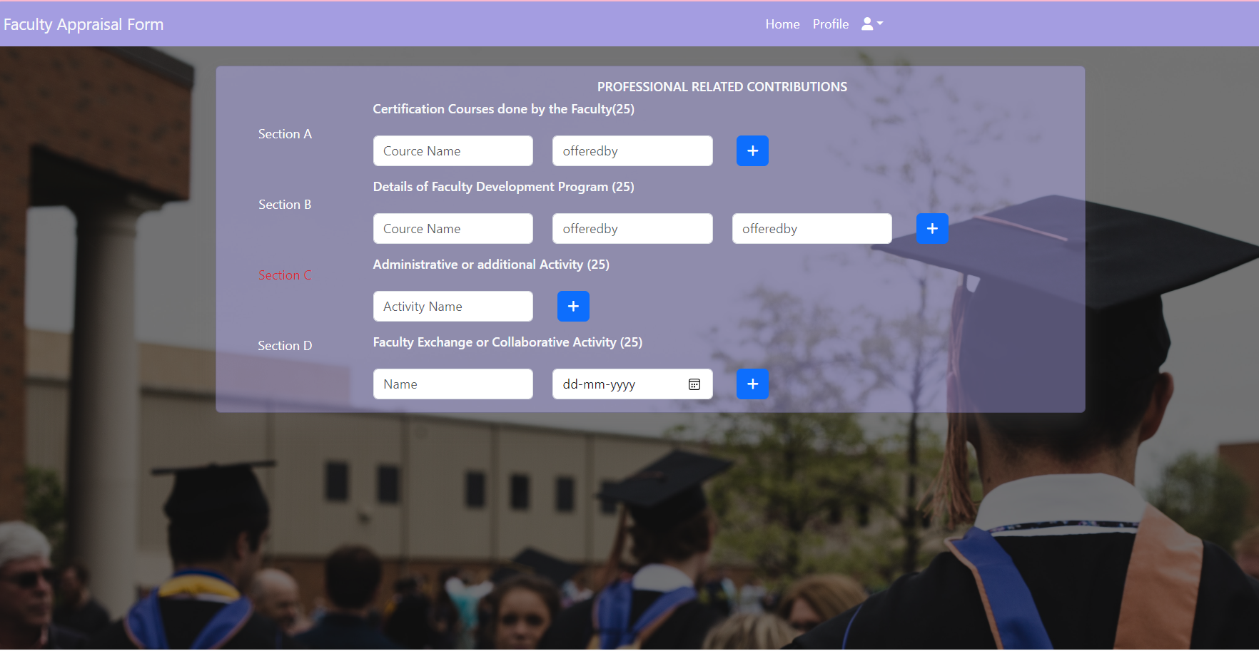
Implementation
Faculty Appraisal Form (Section B & Section C)

Slide 27
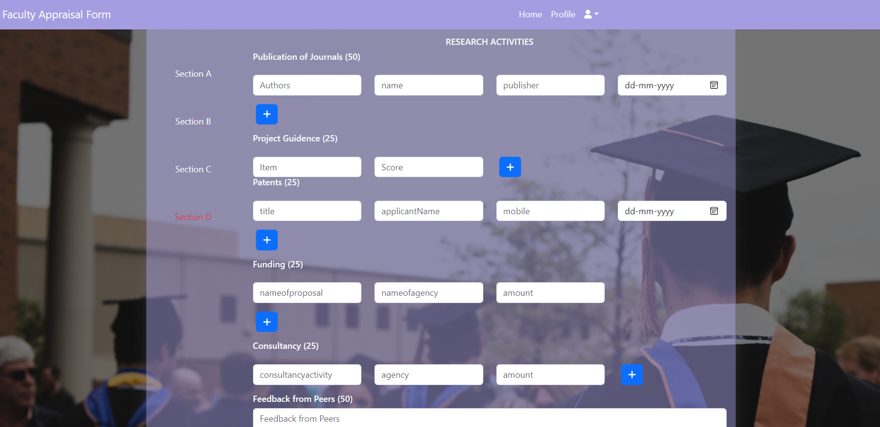
Implementation
Faculty Appraisal Form (Section D)

Slide 28
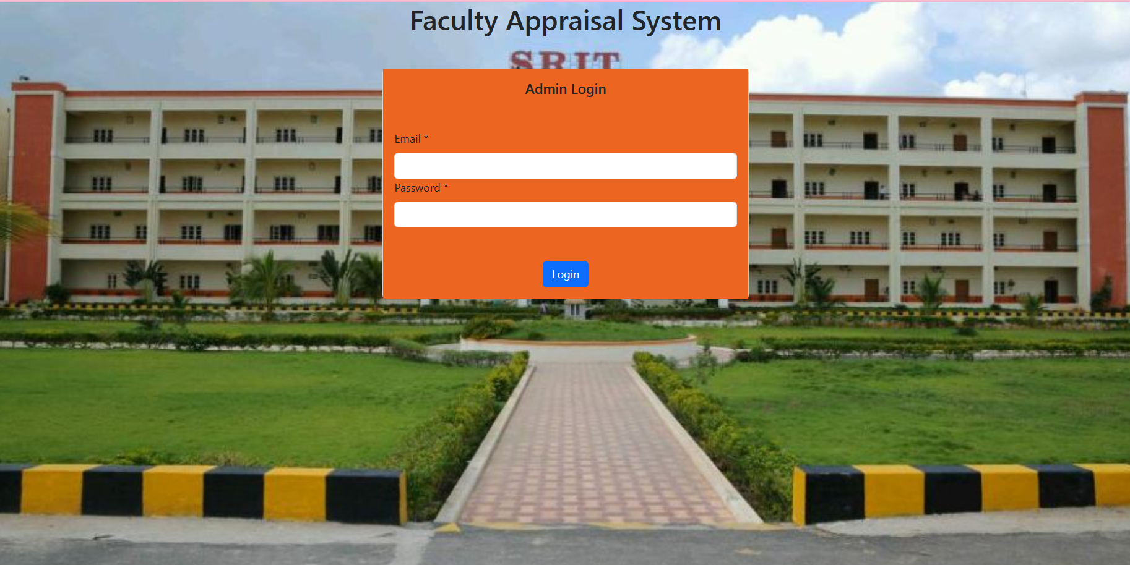
Implementation
Admin Login:

Slide 29
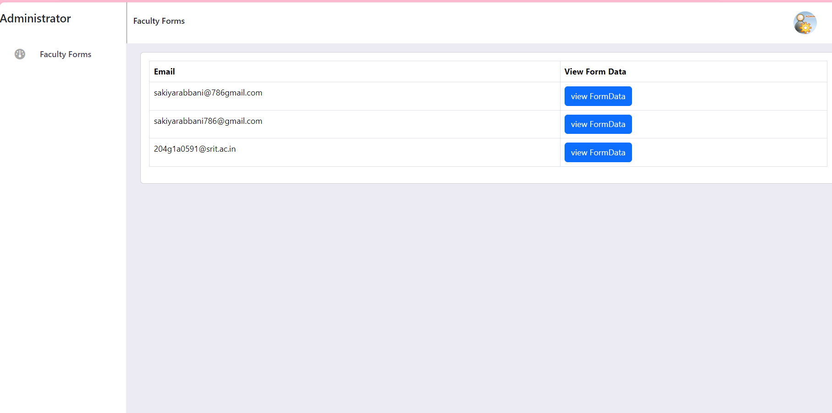
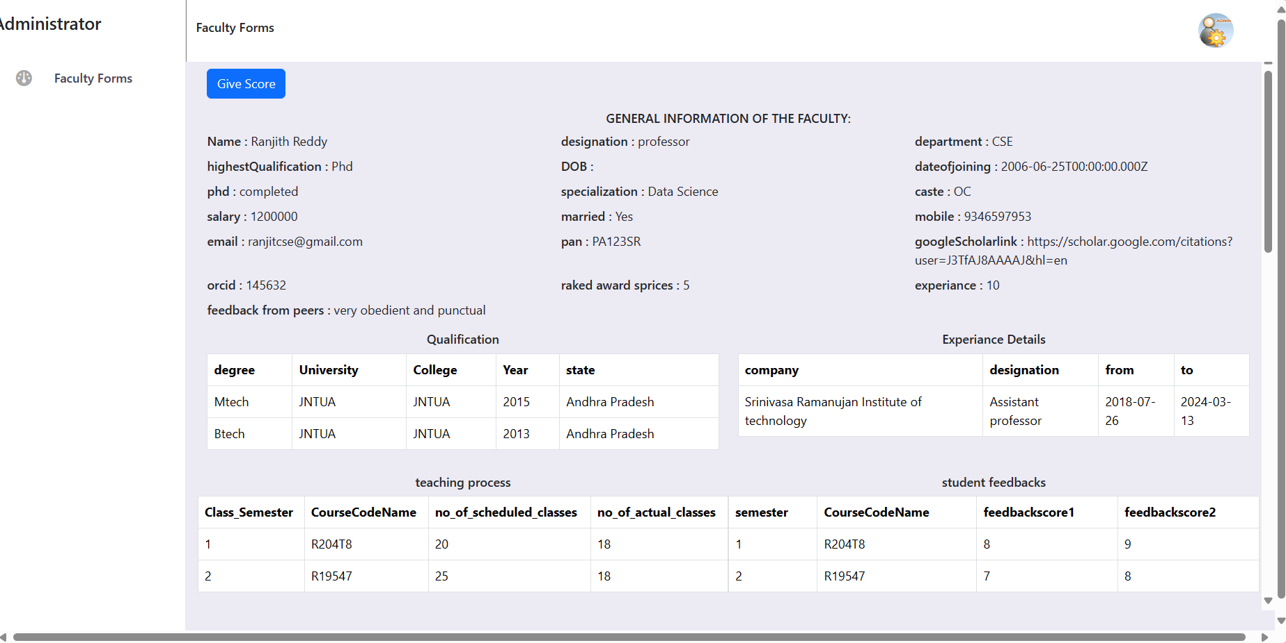
Implementation
Admin Faculty List

Slide 30
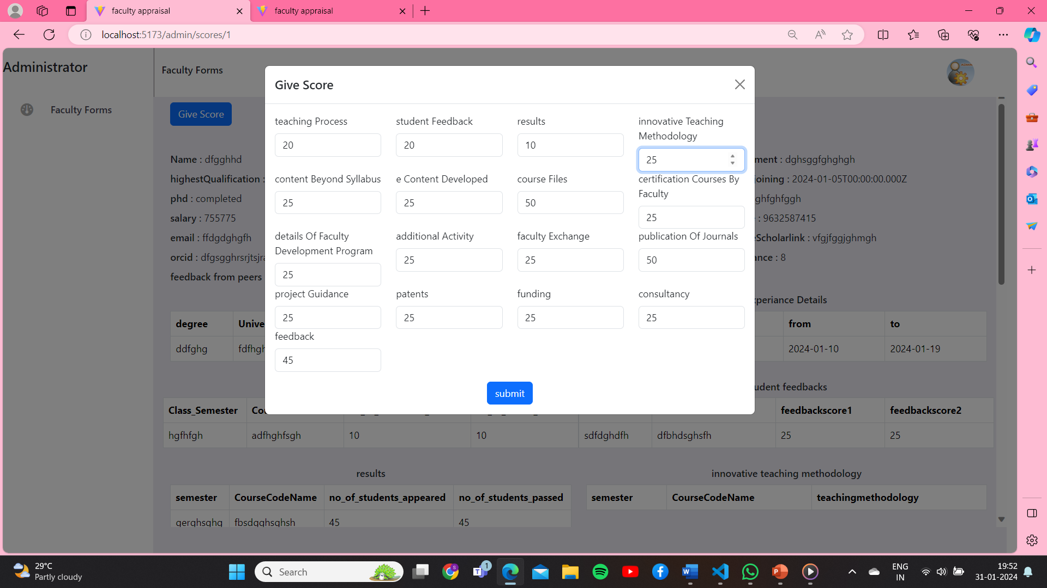
Implementation
Admin Verify Score

Slide 31
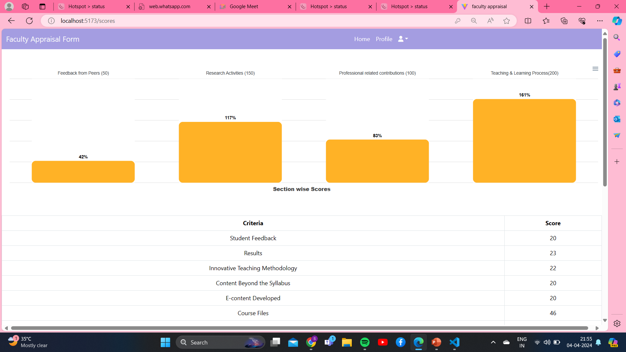
Implementation

Slide 32
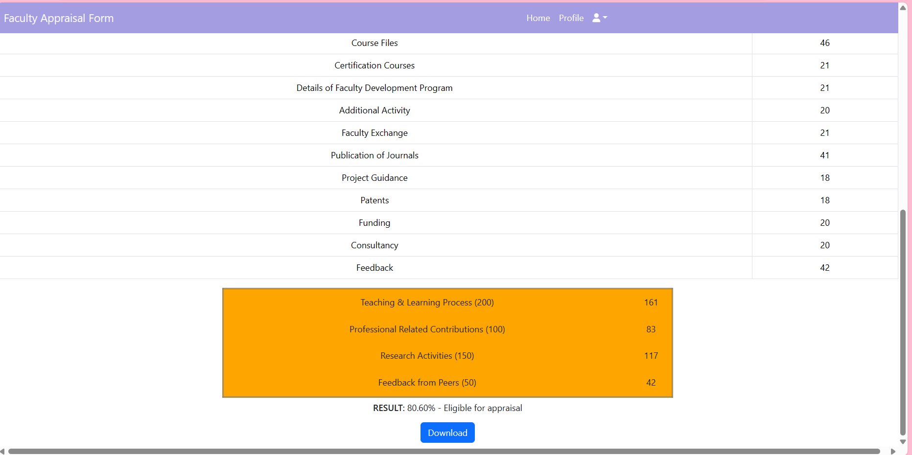
Implementation

Slide 33
Research Paper
Research Paper

Slide 34

Certifications

Slide 35
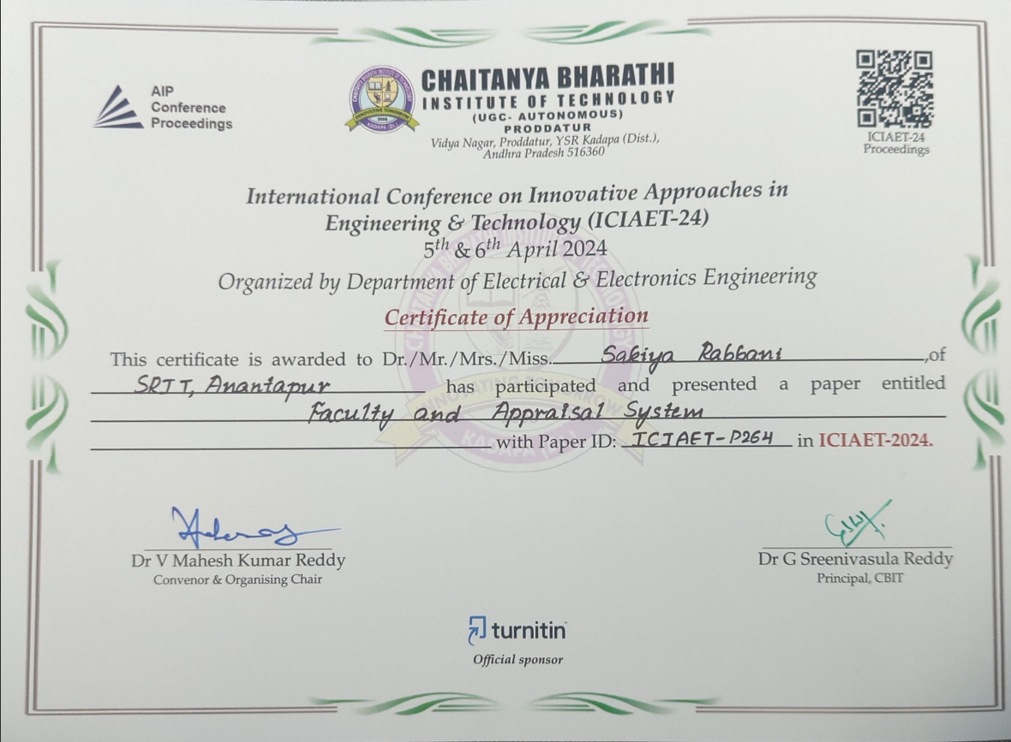
Certifications

Slide 36

Certifications

Slide 37

Certifications

Slide 38

Certifications

Slide 39
Conclusion
In conclusion, the Faculty Appraisal System represents a transformative shift from traditional paper-based assessments to a dynamic, technology-driven approach. By incorporating data analytics and a user-friendly web interface, the system streamlines the appraisal process, providing real-time feedback and visualizations. This innovative solution not only enhances efficiency but also offers a comprehensive and objective evaluation of faculty performance, contributing to the continuous improvement of academic institutions

Slide 40
References
[1]. Haidi Bozikovic, Maja Stula , “Web Design – past , present and future” ,
MIPRO , pp 1-6, 21 May 2018.
[2]. Aisha Khanam, Dr. Shabana Mazhar, “Efficacy of faculty performance appraisal system in higher educational organization” , International journal of management and social sciences (IJMSS) , vol 03 ,pp 1 -11, January 2015.
[3]. Patrik Bores, Aishwarya Chinch pure, Rajat Singh Deepak , Dr. Swati Shinde, “Comprehensive Faculty Appraisal and development system using Data Analytics and Data Visualization”, Fourth International Conference on computing communication control automation(ICCUBEA), pp 1-6 , 25 April 2019.
[4].Colin Reiff, Stefan Oechsle ,Florain Eger,Alexander, “Web Platform for data analysis and monitoring”, Procedia CIRP, pp 1-36, volume 86,2019.

Slide 41
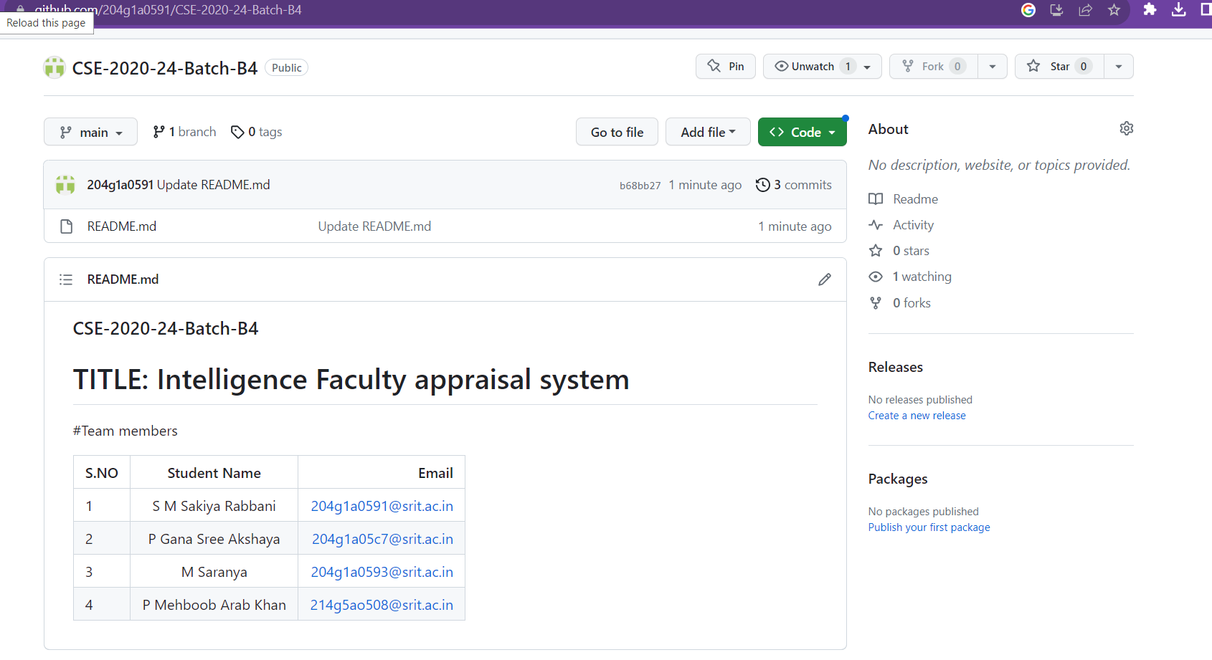
Git Hub Dashboards of each student
https://github.com/204g1a0591/CSE-2020-24-Batch-B4

Slide 42
Thank you !!!

